Slide 1
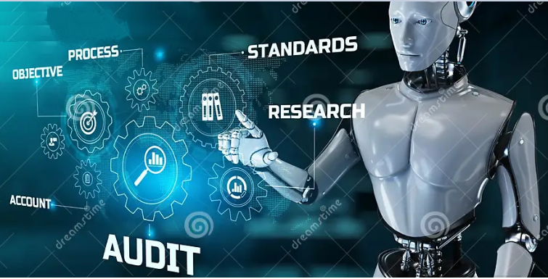
GenAudit
Sugianto Lauw
Tara Tekieh
Xiaoxi Hu

Slide 2

A day in life for an auditor
David
Occupation: Internal Auditor
Pre-Audit Preparation:
Fieldwork:
Analysis:
Report Drafting:
Gather necessary documents
Develop an audit checklist.
Conduct risk assessment.
Collect data via interviews and document reviews.
Test controls and processes.
Verify findings with relevant personnel.
Evaluate internal controls and assess risks.
Conduct root cause analysis.
Summarize key findings and provide recommendations.
Include management responses and risk assessments.

Slide 3






Manual Processes
High Cognitive Load
Report Complexity
Time Constraints
Inadequate Audit Tools
Notes:
Pain Points and Challenges in the Current Process
show the typical steps in the current audit reporting process, highlighting areas of inefficiency and common problems:
Time-Consuming: Manual report writing is slow, requiring auditors to review meeting notes, cross-reference findings, and spend time formatting the document.
Inconsistent Reporting: Different auditors might write reports in varying formats or tones, making consistency a challenge.
Errors and Omissions: Human error can lead to missed details, incomplete reports, or factual inaccuracies.
High Cognitive Load: Auditors need to constantly refer to previous reports to maintain style consistency, increasing mental fatigue.
Lack of Standardization: Without a unified format or style guide, reports can vary greatly, making it difficult for stakeholders to quickly grasp findings.
You can emphasize these points by showing metrics like:
Average time spent on generating a single report.
Error rates or inconsistencies in past reports.
Feedback from stakeholders on the clarity or readability of reports.

Slide 4
GenAudit: Driving significant business impact
For a large organisation conducting many audits annually, this translates to:
Reduction in report writing time from weeks to hours.
Increased consistency across audit reports.
Faster delivery of insights to stakeholders.
More time for high-value analysis and recommendations.
Improved risk management through faster issue identification.
GenAudit

Slide 5
Demo

Slide 6








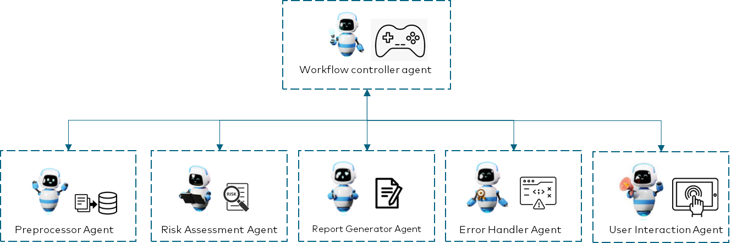

System Architecture
Unity Catalog
Model Serving
Files
Evaluation
Input files
UI Application
Ingest docs
Users
Audit report
Audit report
Llama3.1 70B LLM
DBFS
Volumes
GenAudit
Model Serving
Llama3.1 70B LLM

Slide 7

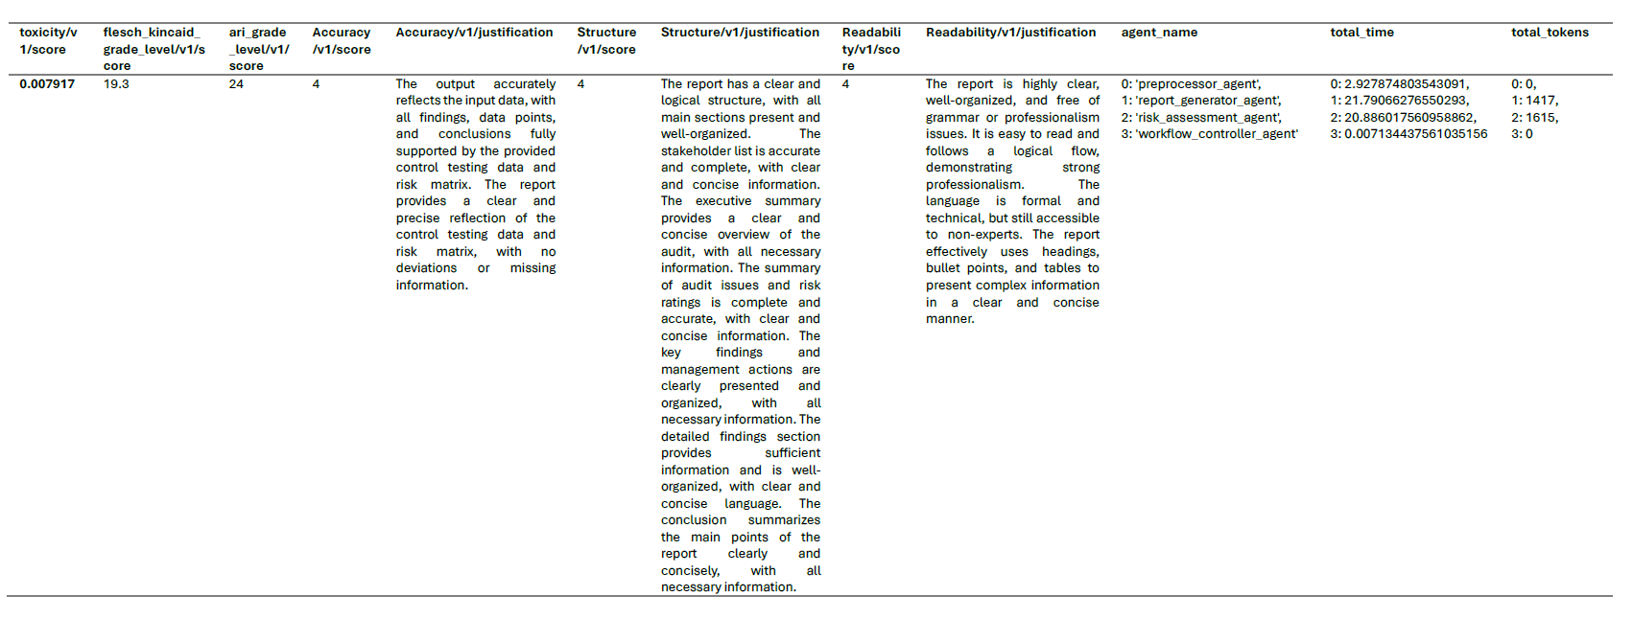
We use LLM as a Judge
Evaluation - Tara
Content Accuracy
Structure Accuracy
Readability

Slide 8

Further work
Adding LLM to the workflow controller that will plan and manage the audit report generation process.
As the requirement grows, we can add analyser agent that can analyse all the input files and come up with the insights and add it to the workflow.
We can also add context handler agent that will manage which agents needs context to certain data as needed (not all agents need access to all data)
Improve on the UI to show more of the workflow progress.
LLM that can analyse the report structure of previous report and use that structure to create a new report based on the previous report structure.

Slide 9
Thank you

Slide 10
We use LLM as a Judge
We asked LLM Judge to judge:
Content Accuracy
How accurate is the generated content comes input files?
Structure Accuracy
How accurate is the agents in following the structure from previous report?
Readability
Clarity, coherence, grammar, professionalism.

Slide 11







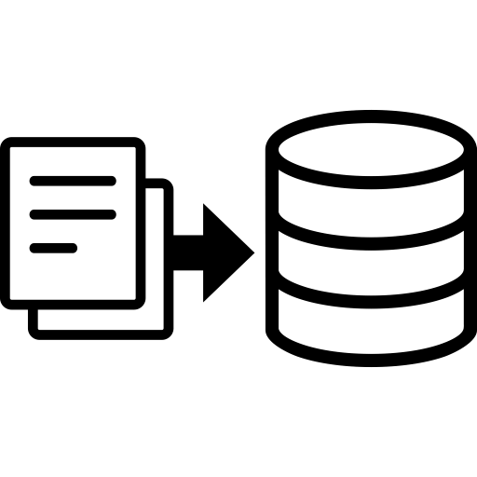
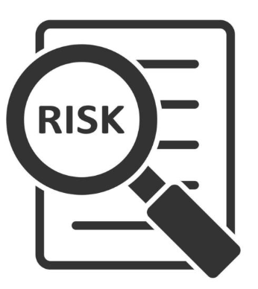

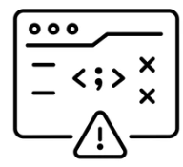

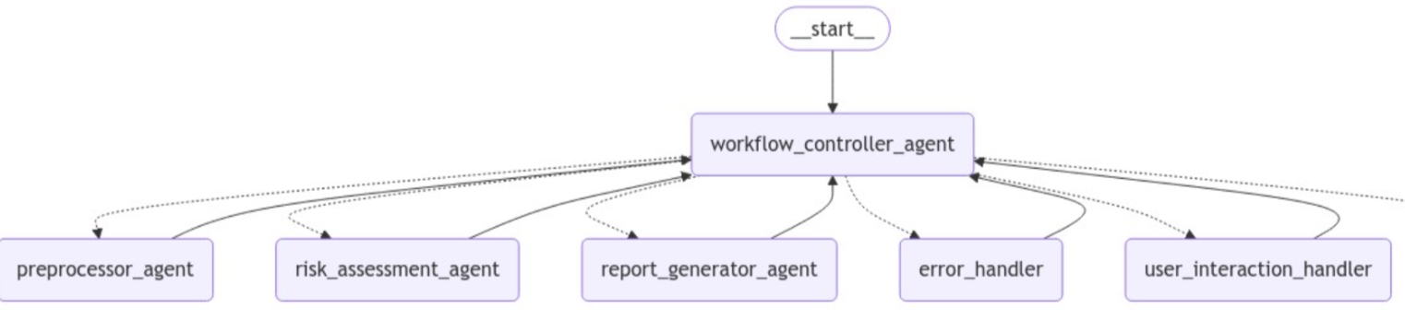
Demo
Workflow controller agent
Preprocessor Agent
Risk Assessment Agent
Report Generator Agent
Error Handler Agent
User Interaction Agent

Slide 12
Business impact
For a large institution conducting many audits annually, this translates to:
Reduction in report writing time from weeks to hours.
60% decrease in auditor time spent on documentation. (re)
Increased consistency across audit reports.
Faster delivery of insights to stakeholders.
More time for high-value analysis and recommendations.
Improved risk management through faster issue identification and reporting.

Slide 13
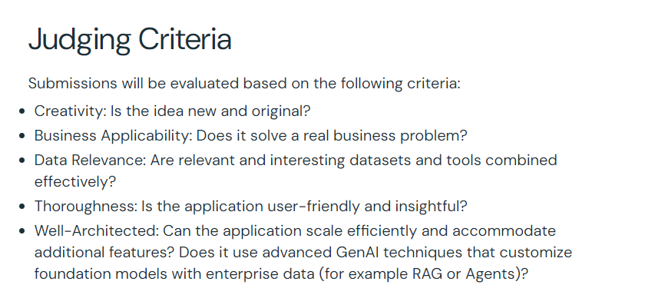
For reference
https://www.databricks.com/blog/announcing-generative-ai-world-cup-2024-global-hackathon-databricks

Slide 14
What if …?
Notes:
Pain Points and Challenges in the Current Process
show the typical steps in the current audit reporting process, highlighting areas of inefficiency and common problems:
Time-Consuming: Manual report writing is slow, requiring auditors to review meeting notes, cross-reference findings, and spend time formatting the document.
Inconsistent Reporting: Different auditors might write reports in varying formats or tones, making consistency a challenge.
Errors and Omissions: Human error can lead to missed details, incomplete reports, or factual inaccuracies.
High Cognitive Load: Auditors need to constantly refer to previous reports to maintain style consistency, increasing mental fatigue.
Lack of Standardization: Without a unified format or style guide, reports can vary greatly, making it difficult for stakeholders to quickly grasp findings.
You can emphasize these points by showing metrics like:
Average time spent on generating a single report.
Error rates or inconsistencies in past reports.
Feedback from stakeholders on the clarity or readability of reports.

Slide 15

GenAudit
Notes:
Hello everyone, We are excited to present our Hackathon project GenAudit, an innovative solution that's transforming how we approach audit report generation in the financial services industry.

Slide 16
Challenges and Pain Points in the Current Audit Report Process: Manual Efforts, Time Pressures, and Tool Limitations
Pre-Audit Preparation:
Fieldwork:
Analysis:
Report Drafting:
Collect data via interviews and document reviews.
Test controls and processes.
Verify findings with relevant personnel.
Evaluate internal controls and assess risks.
Conduct root cause analysis.
Summarize key findings and provide recommendations.
Include management responses and risk assessments.
Gather necessary documents
Develop an audit checklist.
Conduct risk assessment.
Pain points and challenges (need to modify):
Manual Processes and Complexity
Time Constraints
Inadequate Audit Tools

Slide 17

Solution
Users
Unity Catalog
Input files
Audit report
Files
UI Application
Ingest
docs
Volumes
Model Serving
Llama3.1 8B LLM

Slide 18
Audit Planning
Post-Audit Review
Fieldwork and
Data Collection
David
Occupation: Internal Auditor
Analyse Findings
Review and Finalize the Report
Develop Recommendations
Draft the Audit Report

Slide 19
Current Audit Report Process:
Pre-Audit Preparation:
Fieldwork:
Analysis:
Report Drafting:
Collect data via interviews and document reviews.
Test controls and processes.
Verify findings with relevant personnel.
Evaluate internal controls and assess risks.
Conduct root cause analysis.
Summarize key findings and provide recommendations.
Include management responses and risk assessments.
Gather necessary documents
Develop an audit checklist.
Conduct risk assessment.

Slide 20
Manual Processes
High Cognitive Load
Report Complexity
Time Constraints
Inadequate Audit Tools
Notes:
Pain Points and Challenges in the Current Process
show the typical steps in the current audit reporting process, highlighting areas of inefficiency and common problems:
Time-Consuming: Manual report writing is slow, requiring auditors to review meeting notes, cross-reference findings, and spend time formatting the document.
Inconsistent Reporting: Different auditors might write reports in varying formats or tones, making consistency a challenge.
Errors and Omissions: Human error can lead to missed details, incomplete reports, or factual inaccuracies.
High Cognitive Load: Auditors need to constantly refer to previous reports to maintain style consistency, increasing mental fatigue.
Lack of Standardization: Without a unified format or style guide, reports can vary greatly, making it difficult for stakeholders to quickly grasp findings.
You can emphasize these points by showing metrics like:
Average time spent on generating a single report.
Error rates or inconsistencies in past reports.
Feedback from stakeholders on the clarity or readability of reports.

Slide 21
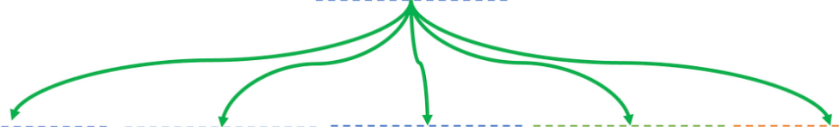
Demo
Workflow controller agent
Preprocessor Agent
Risk Assessment Agent
Report Generator Agent
Error Handler Agent
User Interaction Agent

Slide 22











Solution

